Slide 1
Custom OCP automation the DepOps way
By : Oren Oichman
Title: Senior Consultant - Red Hat
ooichman@redhat.com
IRC: two_oes/ooichman

Slide 2

Why are we here ?
A good Admin provide delegation tools for his customers
Admin == Developer (what ???)
To Take our ocp deployment to the next level
Oren Oichman - custom K8S automations with Operators
Notes:
I want to change yourself on the philosophical level and ask yourself (how does the operator completes the cycle)

Slide 3


Gaining Experience In ...
See the process through the developers eyes
Understand the value of DevOps for the infrastructure
Building Openshift operators using ansible roles
Maintaining internal OLM (OLM ?)
Oren Oichman - custom K8S automations with Operators

Slide 4
Plans for today ...
Build a containerized application using GO lang and deployment on OCP
Getting to learn the Kubernetes Ansible module
Building an Ansible k8s operators
Creating and maintaining custom OLM (OLM?)
Oren Oichman - custom K8S automations with Operators

Slide 5


To Serve a developer is be a developer...
Taking Infrastructure from granted
Code development thinking (think big fix small)
Working in agile development small sprint (devops)
One Git (ring) to rule them all.
Oren Oichman - custom K8S automations with Operators

Slide 6

Operations vs Development
Expertise in many differents areas (langs, tool, tech)
Lack of tests
Pure documentation
Just fix it, do not touch it if it's works
Same language, tools, tech
Unit tests, integration tests, manual testing, etc
At worse case, code is your documentation
Well defined development life cycle
Operate with Operators SDK

Slide 7

Stop OPS
Hide complexity under automation tools
Test your tools, write unit and integration tests
At worse case, code is your documentations
Well defined development life cycle
Operate with Operators SDK

Slide 8
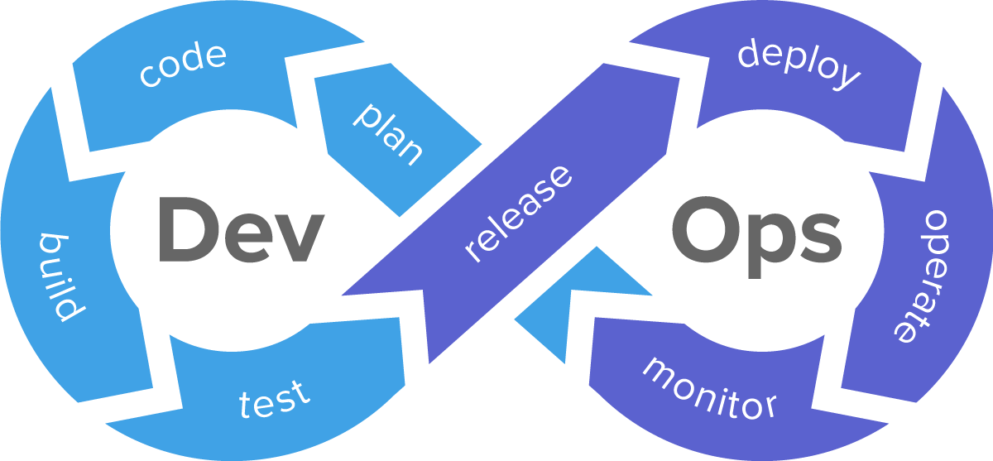
What is actually DevOps ?
Oren Oichman - custom K8S automations with Operators

Slide 9

Exercise 1 :
Building hello-go
Oren Oichman - custom K8S automations with Operators

Slide 10

Thank you
Red Hat is the world’s leading provider of enterprise open source software solutions. Award-winning support, training, and consulting services make
Red Hat a trusted adviser to the Fortune 500.

